Slide 1
UD
Migration
Testing Report
V1.0
26/9/2022
Notes:
V1.2

Slide 2
Approach

Slide 3
NAS Migration – Problem Space
Ship Databox (CBA)
MSFT Extract into Storage Account
(Avanade)
Unzip w/password
(Avanade)
TVT
(Avanade)
SkySync to SPO
(Avanade)
Map permissions
(Avanade)
Initial BVT
(Nishant)
Cutover
(Avanade)
Map source folders to SPO sites
Archive to Cold Storage
(Avanade)
Define Archiving policy
(Mark)
Licensing SPO/SkySync
(Avanade/CFS)
Ongoing Incremental
(Avanade)
BVT
(Business)
Define Cold storage Recovery Process
(Avanade)
OCM comms
(Catherine)
Define SkySync jobs
(Avanade)
UDA Discovery & Treatment
(Richard)
App Data excepted from Migration (16)
Define permissions model
Well Defined / Well understood
To be defined / Not so well understood
Some automation will be required based on mapping (Avanade)
To be confirmed:
Initial cut (Avanade)
CFS to validate with the business

Slide 4
Home Drive Migration – Problem Space
Ship Databox (CBA)
MSFT Extract into Storage Account
(Avanade)
Unzip w/password
(Avanade)
TVT
(Avanade)
SkySync to SPO
(Avanade)
Initial BVT
(Nishant)
Cutover
(Avanade)
Licensing SPO/SkySync
(Avanade/CFS)
Ongoing Incremental
(Avanade)
BVT
(Business)
OCM comms
(Catherine)
Define SkySync jobs
(Avanade)
UDA Discovery & Treatment
(Richard)
Well Defined / Well understood
To be defined / Not so well understood
Assume no archiving will be conducted

Slide 5
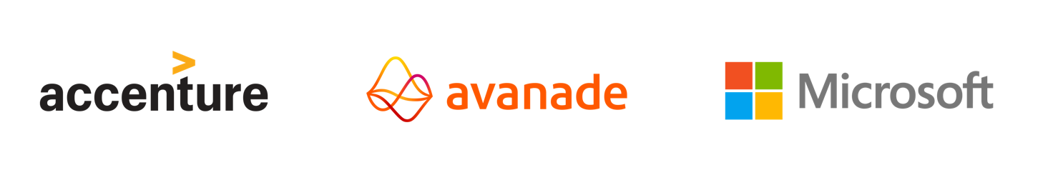
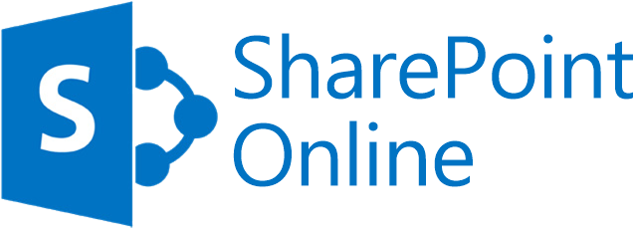
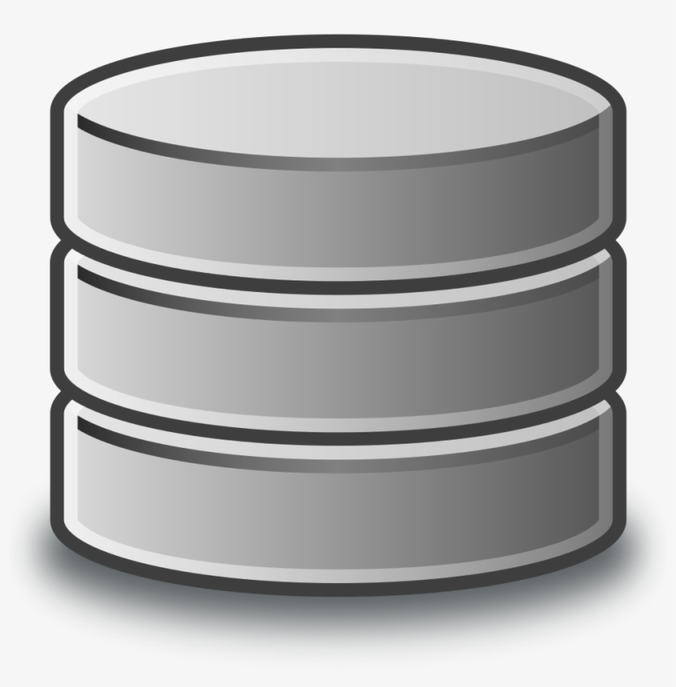
High Level Overview
NAS Data to SharePoint Online Deployment and Migration for CFS is proposing to use an “Out of Band” data migration approach using drive shipping using the Azure Data Box service to eliminate the need to transfer large volumes of data over the network.
DATA EXTRACTION
DATA INGESTION
DATA MIGRATION
(Estimated extraction throughput of 480MBps)
(Estimated ingestion throughput of 1TB/day)
1
Provision Azure Storage Accounts & Private Endpoints
CFS Office 365 Tenant
1
Ship Azure Data Box to CBA
CFS Azure
1
CFS to add passwords to keyvault for zips
2
Share X
Share Y
Share Z
Extract Databox
1.5TB/hour
Data copied from Blob to Files
2.5 TB/hour
4
Scripted Copy of Data to Azure Data Box
Connect Azure Data Box to File Server
2
2
License Skysync
CBA
2
8
Migrate Data using SkySync
5
Merge into Target area
7
Merge to cold storage
(Optional)
Ship Azure Data Box to Microsoft
TVT
5
6
3
Run Inventory Tool
Unzip to TVT Staging
4
3
Azure
Data Box
Azure
Data Box
Azure Storage
File Server
Download to disk 1.2 TB/Hour
CFS Azure
Responsible:
x
x
x
x
5
Avanade Microsoft CFS CBA

Slide 6
Data Migration – Test Scenario
Decisions:
Warm storage for short term recovery + move to cold storage later. Or archive directly to cold storage and wear the increased costs of recovery
TVT tool: Treesize Pro*
Migration tool: Currently using SkySync
DATA MIGRATION
CFS Office 365 Tenant
Responsible:
x
x
Avanade
CFS
Site X
Site Y
Site Z
4
TVT needs its own location, especially for incremental to simplify confirmation of file/folder count
5
TVT currently using TreeSize Pro. Need to procure license if this will be the ongoing tool
License Skysync
2
Migrate Data using SkySync
8
4
Mapping file NAS -> SPO
6
Cold storage to be determined as part of Phase 2.2 scope.
Merge into Traget area
7
Archive Policy
7
Mapping file is required for this step
3
Merge to cold storage
(Optional )
6
8
Create SkySync jobs set running for ongoing sync
TVT
5
2
Skysync currently licensed for R1 scope only
Unzip to staging area
4
Define criteria for what data should be archived
3
4
Map folder/permission structure from NAS to SPO
Azure Blob
CFS Azure
6
*CBA have recommended this tool

Slide 7
Constraints
SkySync licensing costs ~1000k USD per terabyte migrated
Jobs need to be accurately defined early as recreating jobs consumes additional licenses
Azure File Stores have an upper limit of 100 TB
Storage consumed can be up 3 times the original data set – initial + incremental + extracted & merged data
File when extract from Azure files to Azure files can be limited by folder creation operations, which drop as low as 10 folder/sec. Some of the zips have over 1 million folders. Microsoft have confirmed that there is a metadata limit (creation of files and folders) on Azure File Share of “2,000 operations per file share” that is the likely cause. Microsoft have recommended that we download these files to local disk and extract them to local disk before uploading back to Azure Files.
Azcopy: Any empty folders will not be processed, because source and/or destination doesn't have full folder support
Feature | Microsoft 365 A3, E3, G3 & A5, E5, G5
Total storage per organization | 1 TB plus 10 GB per license purchased
Max storage per site (site collection) | 25 TB
Sites (site collections) per organization | 2 million
File upload limit | 250 GB
File path | The entire decoded file path, including the file name, can't contain more than 400 characters for OneDrive, OneDrive for work or school and SharePoint in Microsoft 365
Lists | A list can have up to 30 million items and a library can have up to 30 million files and folders

Slide 8
TVT

Slide 9
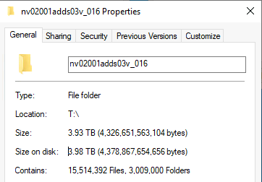
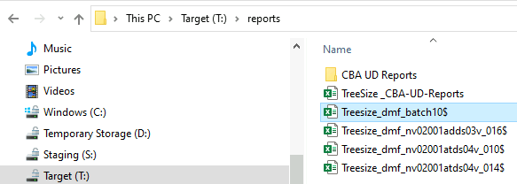
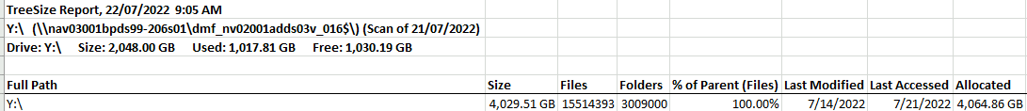
TVT Process
Extract the DMF reports (not the UD reports)
3. Confirm file and folder count*
2. Locate the relevant NAS path

Slide 10
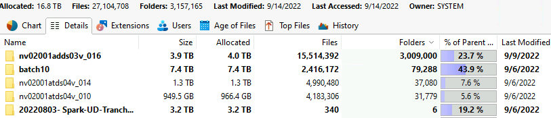
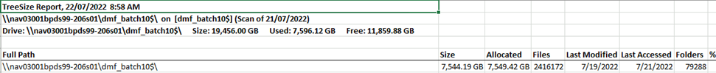
Use Tree-size to compare file & folder count. There should be an exact match. Report any discrepancies to CBA DMF team

Slide 11
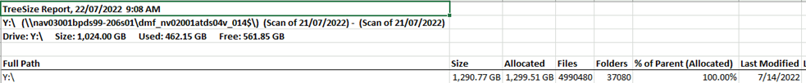
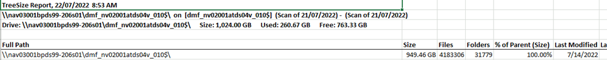

Slide 12
Throughput Testing

Slide 13
Test 3 Objectives
Test 3 Initial (Large) extract for NAS/File shares – will include performance benchmarking for tranche planning
Results:
Azure Databox extraction: 1.5TB/hour
Azure Blob to Azure Files: 2.5TB/hour
Azure File extract to Azure File: 5.4 TB/day MAX*
Azcopy to local disk copy : 1.2 TB/Hour
Azure Files to SharePoint (Skysync) ~ 550GB/day
Longest (single threaded job) 7.36 TB Extracted in 3 Days 7hrs
Shortest (multi-threaded job x6) 3.22TB extracted in 1 day 21 hours and 44 mins
Azcopy to local disk
(1.2B/Hour)
Longest (single threaded job)
7.36 TB Extracted in 3 Days 7hrs
12 days/Databox
(4TB/day)
1 day
(1.5TB/hour)
8 weeks
(550 GB/day)
5 days
4 days
x weeks
Ship Databox
Copy Data to Databox
Ship Databox
Ingest Data to Azure
Unzip Data
Data Verification & Mapping
Data Transfer to O365
CFS
(John S)
CBA
(Data Factory)
CBA
Avanade
Avanade
MSFT
Avanade
*File when extract from Azure files to Azure files can be limited by folder creation operations, which drop as low as 10 folder/sec. Some of the zips have over 1 million folders

Slide 14
CBA Extraction Throughput
Breakdown of CBA’s Data Migration Factory (DMF) timings for UD test migration tranche 3:
NAS Scope: 14 TB (2.4 m files / 86 k folders)
DMF Packing: 80 hrs* or 6 hrs per TB or 4 TB per day
* 48 hrs zipping + 32 hrs copying to Azure Databox
If we extrapolate to current max scope (as per August UD Inventory):
NAS/HD Scope: 180 TB* (444 m files / 21 m folders)
DMF Packing: 45 days or 7.5 weeks
* 168 TB NAS + 12 TB Home Drives
Notes
DMF timings exclude the first copy step (from source NAS to DMF NAS) as NetApp will utilise a quick replication tool for this step in the real initial migration tranche.
The no. of files & folders can cause the timings to vary significantly. This test scope includes some App related data (lots of small files & folders) which represents the slower end of packing & unpacking.
We can likely scale up DMF if needed (e.g. additional PCs & Azure Databoxes) but will assess as the initial tranche progresses and decision re max of NAS scope.
Max of NAS scope is still to be confirmed in next week’s workshop e.g. whether App related data is included or excluded from the initial & delta migration tranches.
Documentum excluded from current max scope due to relatively small size.

Slide 15
Test 3 Objectives
Test archival process for cold data with Test 3
Results: Archival can be achieved with a number of options, including robocopy and azcopy (which has the advantage of offloading the transfer to Azure). Recovering files from archive storage has a cost associated with it that need to be weighed up/against the storage account savings
Confirm with MSFT if they can extract the Databox directly to file storage
Results: Case raised with MSFT 2208250030001184. Can be extracted to Azure Files however this will be unlikely to be used due to performance issues
(Optional) Investigate the feasibility of incorporating a sync of file deletion from source
Results: Test not conducted

Slide 16
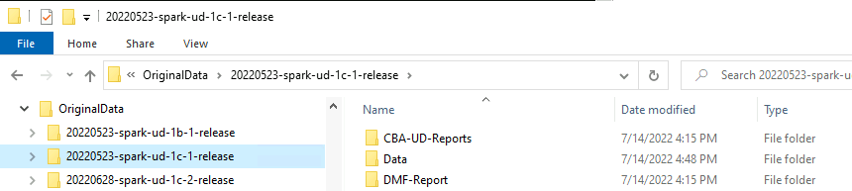
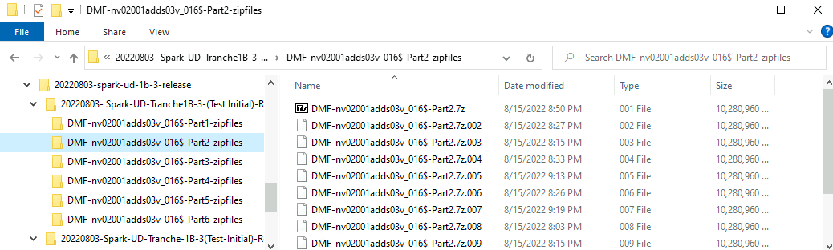
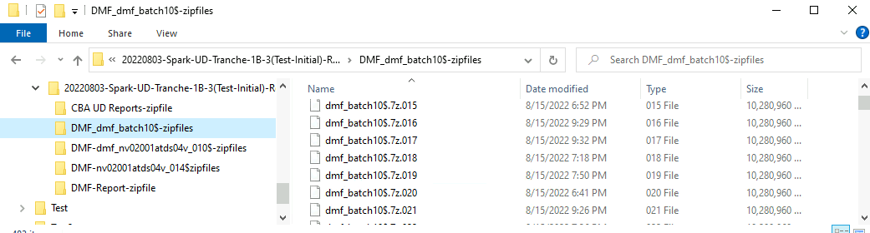
Test 3 Objectives
(Optional) Automation
Data coming from initial test tranches were in a different structure. All data was in a data folder. For 1b-3 there were two folders with data contained within
Some folders were zipped into multiple folders and then into multipart zips.
Folders come with DMF and batch 10 prefixes – which is from CBAs staging environment
Summary: As data is coming in inconsistent format making automation extremely challenging. Have fed this back to CBA and they will enforce more consistency in future DMF releases

Slide 17
Re-test & Benchmarking

Slide 18
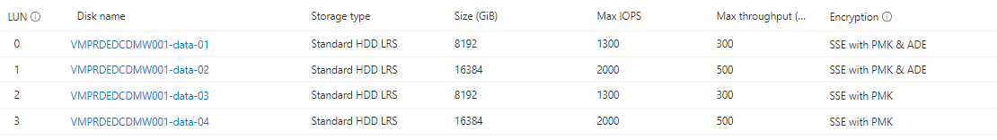
Setup
Due the significant performance issues with Azure Files. A complete extract was re-tested using local disk on an Windows IaaS Server. The setup is detailed below:
VMPRDEDCDMW001
Windows 2022 Datacenter
Standard D8s v3 (8 vcpus and 32 GB RAM)
Disks:
S: (Staging consists of 2 x 8TB disk in a storage pool with a simple (striped) layout virtual disk layout
T: (Staging consists of 2 x 16TB disk in a storage pool with a simple (striped) layout virtual disk layout
*Content needs to be downloaded to local disk and then extract before this job is run

Slide 19
Process
Download from stoprdedcbckmigration001.blob.core.windows.net to S: & T: (just for this run to test performance across multiple virtual volumes
Extract multipart, multipart (its not a typo) from T: to S: (just for this run, hopefully CBA will provide only standard multipart zips from now on). When extracted it does not have the final folder structure it will be in folder format part1, part2, part3…etc
Extract standard multipart from S: to T:
Re-assemble the extracted multipart, multipart to T:
*Content needs to be downloaded to local disk and then extract before this job is run

Slide 20
Scripts
#Download from Blob storage
$sourceSAS = 'xxx'
$sourceFolder = 'databox-root-blockblob-14f667e84dec1aeef2344c28c9ae8816d6e829a7/20220803-Spark-UD-Tranche-1B-3(Test-Initial)-Release'
$source = "https://stoprdedcbckmigration001.blob.core.windows.net/$sourceFolder$sourceSAS"
$target = 'S:\'
azcopy copy $source $target --recursive=true
$sourceSAS = 'xxxx'
$sourceFolder = 'databox-root-blockblob-14f667e84dec1aeef2344c28c9ae8816d6e829a7/20220803- Spark-UD-Tranche1B-3-(Test Initial)-Release'
$source = "https://stoprdedcbckmigration001.blob.core.windows.net/$sourceFolder$sourceSAS"
$target = 't:\'
azcopy copy $source $target --recursive=true
# Unzip multipart, multipart zip
start 7z -bt -oS:\1b-3 -p"yyyy" x "T:\20220803- Spark-UD-Tranche1B-3-(Test Initial)-Release\DMF-nv02001adds03v_016$-Part1-zipfiles\DMF-nv02001adds03v_016$-Part1.7z.001"
start 7z -bt -oS:\1b-3 -p"yyyy" x "T:\20220803- Spark-UD-Tranche1B-3-(Test Initial)-Release\DMF-nv02001adds03v_016$-Part2-zipfiles\DMF-nv02001adds03v_016$-Part2.7z.001"
start 7z -bt -oS:\1b-3 -p"yyyy" x "T:\20220803- Spark-UD-Tranche1B-3-(Test Initial)-Release\DMF-nv02001adds03v_016$-Part3-zipfiles\DMF-nv02001adds03v_016$-Part3.7z.001"
start 7z -bt -oS:\1b-3 -p"yyyy" x "T:\20220803- Spark-UD-Tranche1B-3-(Test Initial)-Release\DMF-nv02001adds03v_016$-Part4-zipfiles\DMF-nv02001adds03v_016$-Part4.7z.001"
start 7z -bt -oS:\1b-3 -p"yyyy" x "T:\20220803- Spark-UD-Tranche1B-3-(Test Initial)-Release\DMF-nv02001adds03v_016$-Part5-zipfiles\DMF-nv02001adds03v_016$-Part5.7z.001"
start 7z -bt -oS:\1b-3 -p"yyyy" x "T:\20220803- Spark-UD-Tranche1B-3-(Test Initial)-Release\DMF-nv02001adds03v_016$-Part6-zipfiles\DMF-nv02001adds03v_016$-Part6.7z.001"
# Re-assemble multipart, multipart zip
start robocopy /e /mt /z "S:\1b-3\Part1" T:\nv02001adds03v_016
start robocopy /e /mt /z "S:\1b-3\Part2" T:\nv02001adds03v_016
start robocopy /e /mt /z "S:\1b-3\Part3" T:\nv02001adds03v_016
start robocopy /e /mt /z "S:\1b-3\Part4" T:\nv02001adds03v_016
start robocopy /e /mt /z "S:\1b-3\Part5" T:\nv02001adds03v_016
start robocopy /e /mt /z "S:\1b-3\Part6" T:\nv02001adds03v_016
*Content needs to be downloaded to local disk and then extract before this job is run

Slide 21
Scripts
#Extract Batch 10 files (multiple folder underneath)
start 7z -bt -oT:\batch10 -p"yyyy" x "S:\20220803-Spark-UD-Tranche-1B-3(Test-Initial)-Release\DMF_dmf_batch10$-zipfiles\dmf_batch10$.7z.001"
# Extract normal files
start 7z -bt -oT:\nv02001atds04v_010 -p"yyyy" x "S:\20220803-Spark-UD-Tranche-1B-3(Test-Initial)-Release\DMF-dmf_nv02001atds04v_010$-zipfiles\dmf_nv02001atds04v_010$.7z.001"
start 7z -bt -oT:\nv02001atds04v_014 -p"yyyy" x "S:\20220803-Spark-UD-Tranche-1B-3(Test-Initial)-Release\DMF-nv02001atds04v_014$zipfiles\nv02001atds04v_014$.7z.001"
# Extract reports
start 7z -bt -oT:\reports -p"yyyy" x "S:\20220803-Spark-UD-Tranche-1B-3(Test-Initial)-Release\DMF-Report-zipfile\DMF-Inventory Listing.7z.001"
start 7z -bt -oT:\reports -p"yyyy" x "S:\20220803-Spark-UD-Tranche-1B-3(Test-Initial)-Release\CBA UD Reports-zipfile\CBA UD Reports.7z.001"
# Incremental
start 7z -bt -oS:\delta\1b-4 -p"zzzz" x "S:\1b-4\CBA UD Reports-zipfiles\CBA UD Reports.7z.001"
start 7z -bt -oS:\delta\1b-4 -p"zzzz" x "S:\1b-4\Data-zipfiles\Data.7z.001"
start 7z -bt -oS:\delta\1b-4 -p"zzzz" x "S:\1b-4\Inventory-zipfile\01. Inventory Listing.7z"
*Content needs to be downloaded to local disk and then extract before this job is run

Slide 22
Metrics
Longest Job: Azure Files → Azure Files (13GB/hour)
7z -bt -oY:\nv02001atds04v_014 –p”xxx" x "Z:\..\DMF-nv02001atds04v_014$zipfiles\nv02001atds04v_014$.7z.001
Folders: 37080
Files: 4990480
Size: 1385956834523 (1,200 GB)
Compressed: 126231871210
Kernel Time = 11834.046 = 3% Cnt: 46816895 MCycles
User Time = 7279.796 = 2% Freq (cnt/ptime): 2449 MHz
Process Time = 19113.843 = 6% Virtual Memory = 1979 MB (87 hours)
Global Time =315242.295 = 100% Physical Memory = 1977 MB
Longest Job*: Local Disk → Azure Files (166GB/hour)
robocopy /e /mt /z "F:\1b-3\Part3" Y:\nv02001adds03v_016
Total Copied Skipped Mismatch FAILED Extras
Dirs : 21471 21471 21471 0 0 138
Files : 49113 6307 42807 0 0 5
Bytes : 2.409 t 1.084 t 1.324 t 0 0 150.0 k
Times : 67:21:22 6:39:48 0:00:00 0:50:05
Speed : 49,704,437 Bytes/sec.
Speed : 2,844.111 MegaBytes/min.
Ended : Friday, August 26, 2022 4:21:20 PM
*Content needs to be downloaded to local disk and then extract before this job is run

Slide 23
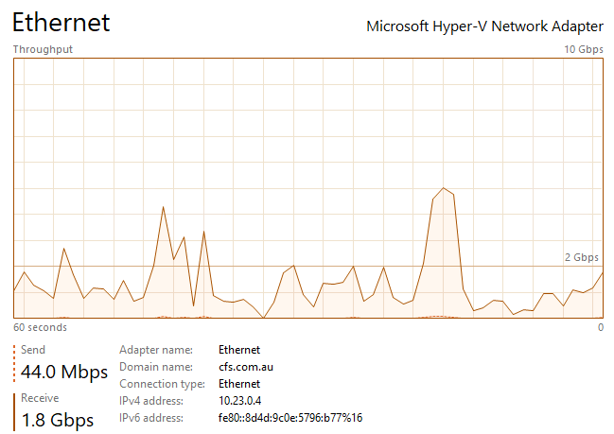
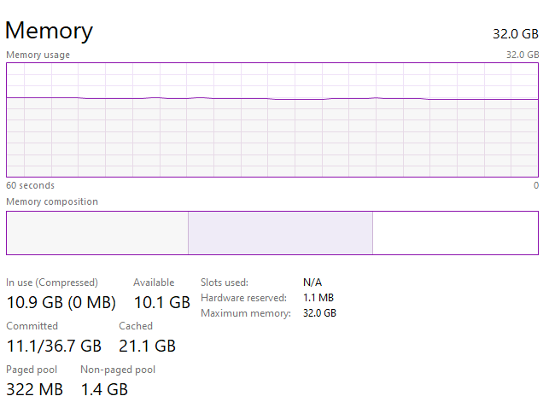
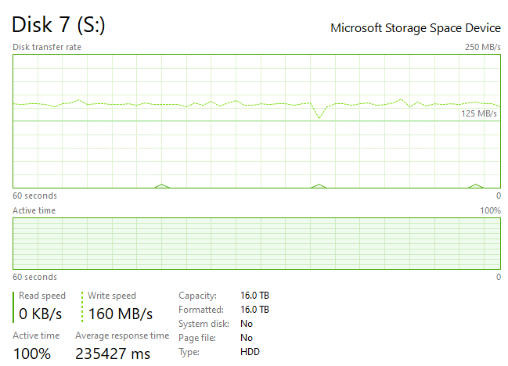
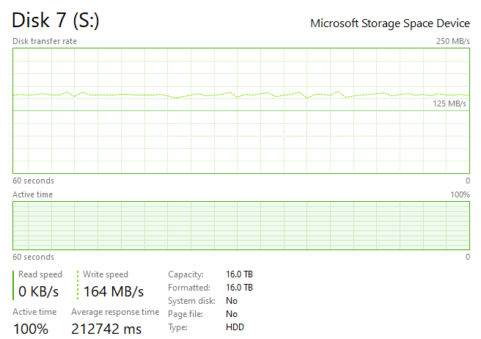
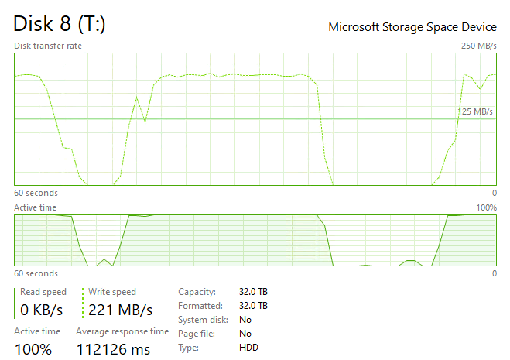
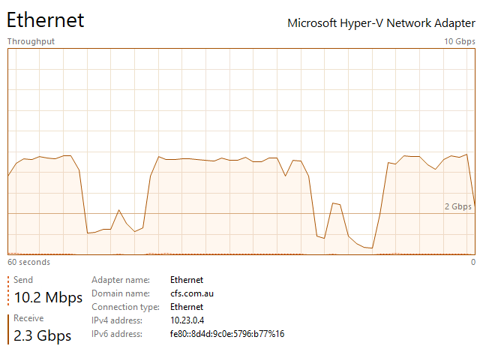
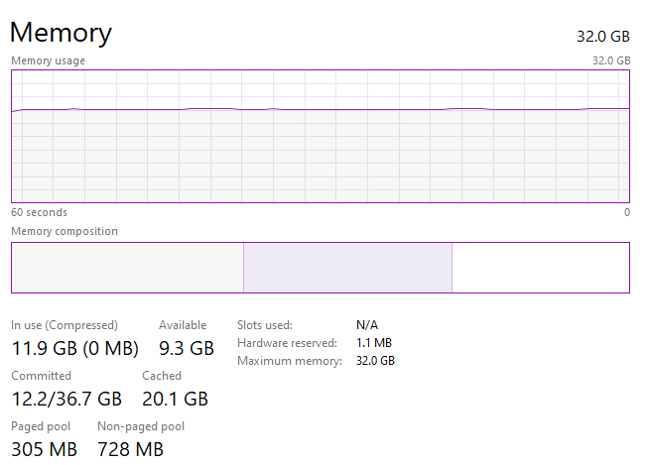
Metrics
Run1
Download azcopy to S:
(S: consist of 2 x 8TB HDD in striped layout; VM Standard_D8s_v3)
Sustained Disk Throughput: 166MB/s
Run 2
Download azcopy to S: & T:
(S: consist of 2 x 8TB HDD in striped layout;
t: consist of 2 x 16TB HDD in striped layout;
VM Standard_D8s_v3)
T: 357 GB/h
S: 412 GB/h
*Content needs to be downloaded to local disk and then extract before this job is run
Notes:
Run2
S:
Elapsed Time (Minutes): 723.6399
Number of File Transfers: 510
Number of Folder Property Transfers: 0
Total Number of Transfers: 510
Number of Transfers Completed: 510
Number of Transfers Failed: 0
Number of Transfers Skipped: 0
TotalBytesTransferred: 5337097969981
Final Job Status: Completed
T:
Job 7be392f8-b746-8541-6e12-47c4dca2246e summary
Elapsed Time (Minutes): 554.5736
Number of File Transfers: 340
Number of Folder Property Transfers: 0
Total Number of Transfers: 340
Number of Transfers Completed: 340
Number of Transfers Failed: 0
Number of Transfers Skipped: 0
TotalBytesTransferred: 3547433180085
Final Job Status: Completed

Slide 24
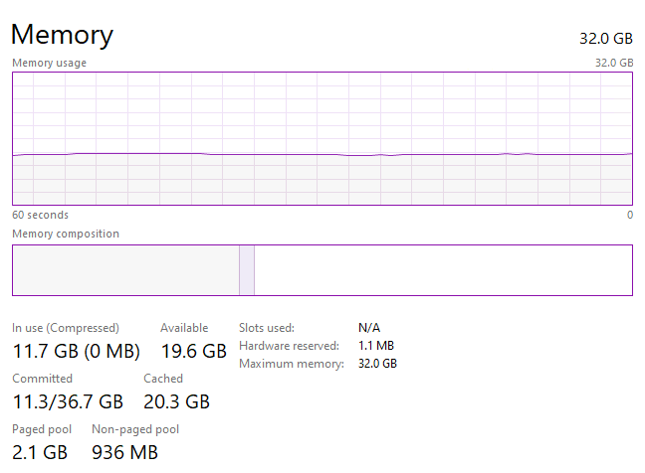
Metrics
Extracting 6 parts multipart zip from T: to S:
3.22TB extracted in 1 day 21 hours and 44 mins
*Content needs to be downloaded to local disk and then extract before this job is run

Slide 25
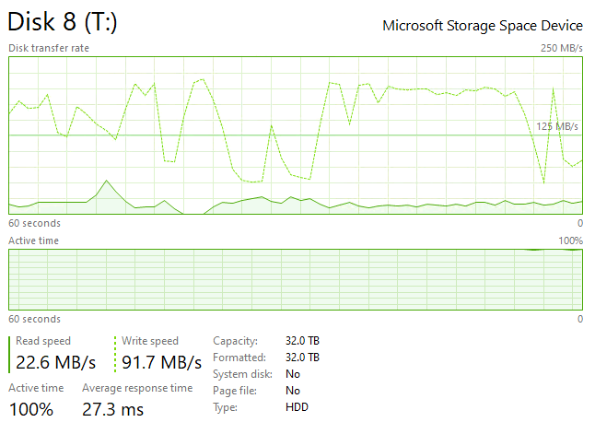
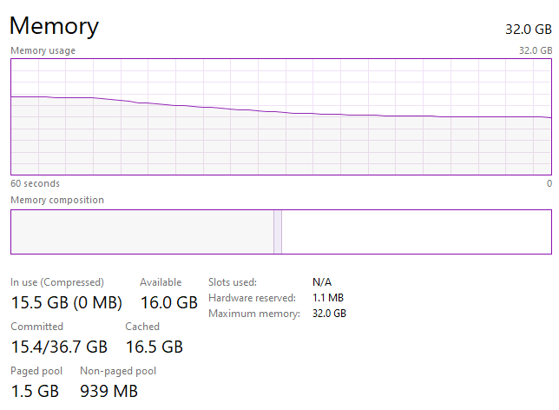
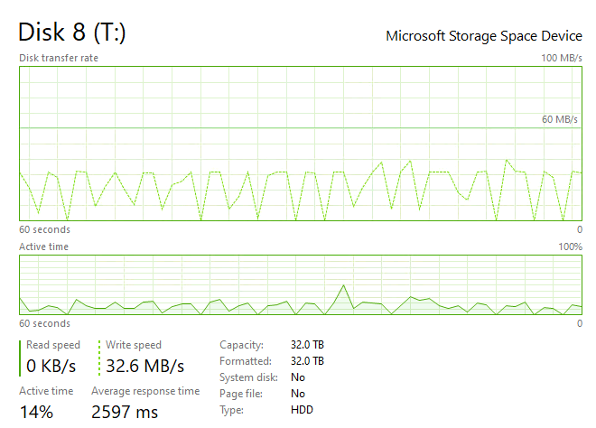
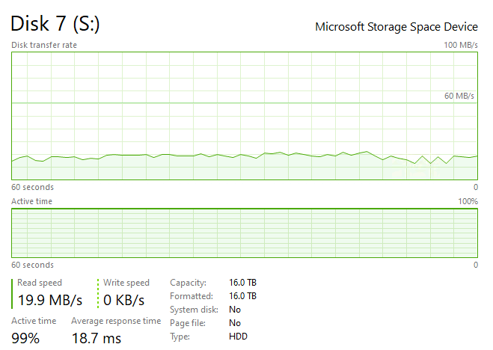
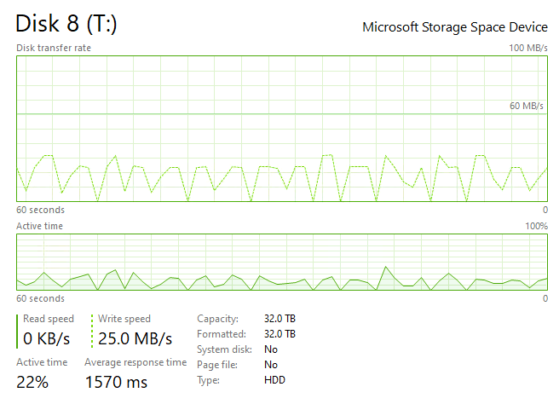
Metrics
Extracting multipart zip from S: to T:
(Initial when other jobs are running)
7.36 TB Extracted in 3 Days 7hrs
When all other jobs have completed:
*Content needs to be downloaded to local disk and then extract before this job is run

Slide 26
Appendices

Slide 27
Naming Convention
Test Tranches
SPARK UD – Tranche 1a-x (Documentum Test Initial)
SPARK UD – Tranche 1b-x (NAS Test Initial) and Tranche 1b-4 (NAS Test Delta)
SPARK UD – Tranche 1c-x (Home Drive Test Initial)
Production Tranches
SPARK UD Tranche 2a-x (Documentum Production).
SPARK UD – Tranche 2b-1, 2b-2, 2b-3, 2b-4….. (NAS Production)
SPARK UD – Tranche 2c-x (Home Drives Production)

Slide 28
CFS IL Data Sources
Source Data | Source Location | Migrate | RFP Migration Tool | RFP Volume | Current Migration Tool | Current Volume | Avanade Migration Phase | Migration Partner
CFSIL Mailboxes | CBA M365 | Yes | Quest OnDemand | N/A | Quest OnDemand | N/A | N/A | NTT
CFSIL Microsoft Teams | CBA M365 | Yes | Quest OnDemand | N/A | Quest OnDemand | N/A | N/A | NTT
CFSIL SharePoint Online & OneDrive | CBA M365 | Yes | Quest OnDemand | N/A | Quest OnDemand | N/A | N/A | NTT
CFSIL Documentum (*New) | CBA On-Prem | Yes | N/A | N/A | New Approach / Tool required | 0.5TB | 2.2 | Avanade – WP5 (Not estimated)
CFSIL Group Drives/NAS Data (*New) | CBA On-Prem | Yes | N/A | N/A | New Approach / Tool required | 175TB | 2.2 | Avanade – WP5 (Not estimated)
CFSIL Home Drives | CBA On-Prem | Yes | SkySync | 23.2 TB (2168 users) | New Approach / Tool required | TBA | 2.2 | Avanade – WP5
CFSIL Identities & Groups | CBA On-Prem | No | N/A | N/A | N/A | N/A | N/A | N/A
CFSIL JIRA / Confluence | CBA On-Prem | Yes | N/A | N/A | New Approach / Tool required | TBC - 2.0 TB? | 2.2 | Avanade – WP5 (Not estimated)
CFSIL Exch 2016 Mailboxes (*New) | CBA On-Prem | Yes | N/A | N/A | TBD (Exch 2016 Hybrid?) | N/A | N/A | CBA
CFSIL SharePoint 2013 | CBA On-Prem | Yes | Sharegate | 0.5 TB | Migrate to CBA SPO then move via T2T | TBA | 2.2 | CBA
CFSIL Windows Devices | CBA On-Prem | No | N/A | N/A | N/A | N/A | N/A | N/A
CFS PMO JIRA / Confluence | CFS Cloud | TBD | N/A | N/A | TBD | TBC | 2.2 | Avanade – WP5 (Not estimated)

Slide 29
